Slide 1
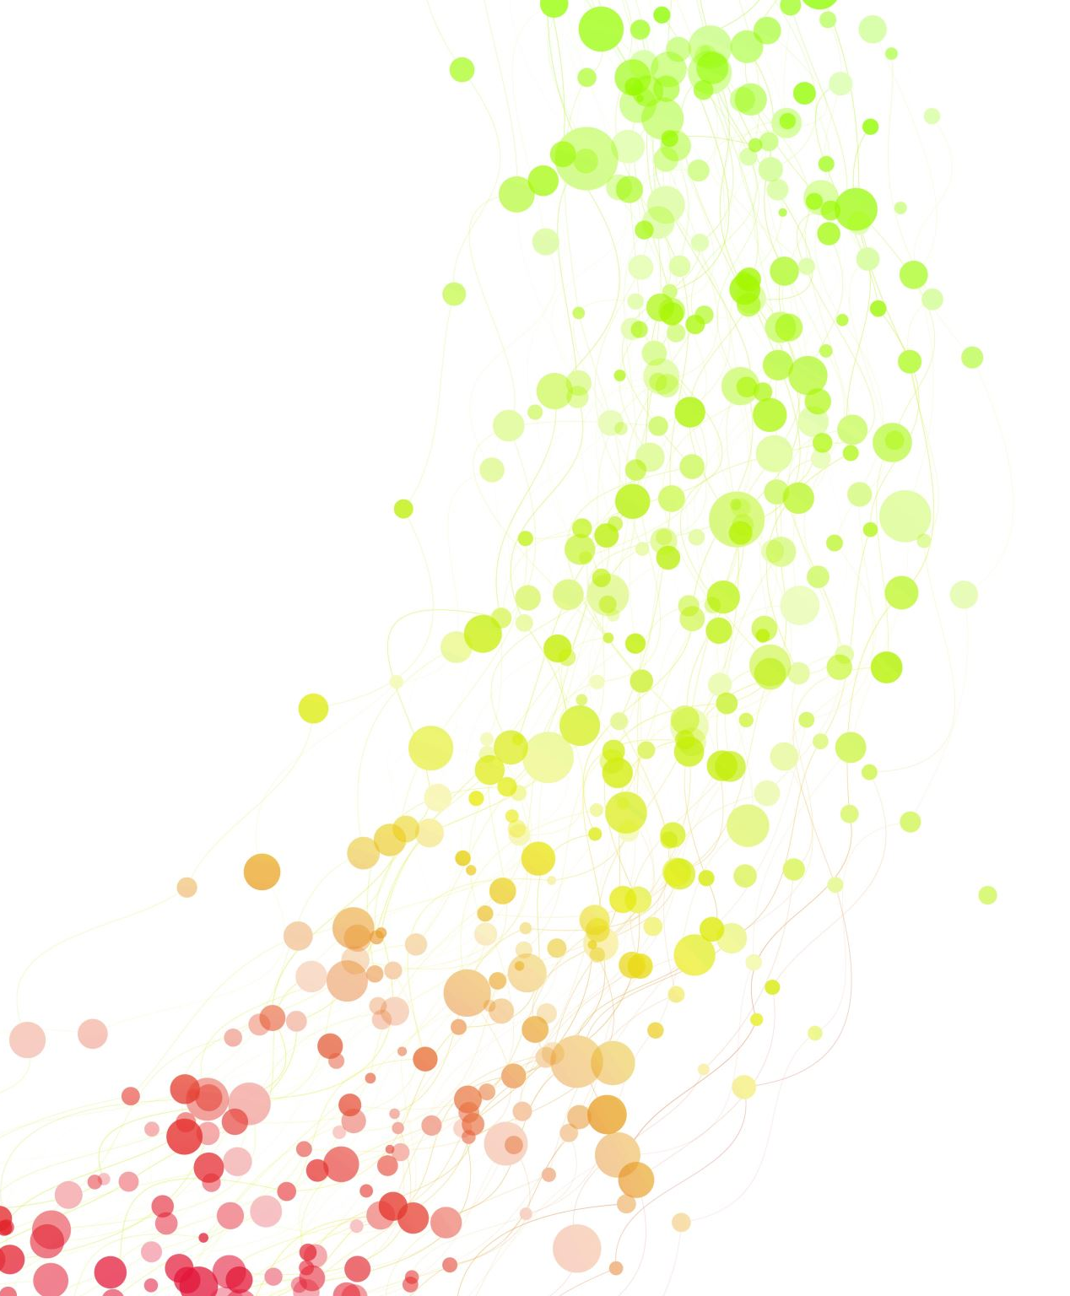
Qualtrics and Experiment Implementation
PHIL246 Lab 9
November 4, 2022

Slide 2
Coming Up
TODAY: submit lab materials
Two sentences, two pictures, within constraints
Everyone in the group should individually submit a copy of the same PDF
NEXT WEEK: lab is asynchronous
There will be a recording for you to watch; nothing in person
Nov 11: SA4 due
Nov 22: Exam 3
Nov 25: no lab – Thanksgiving Break
Dec 8: Lab report due
Everyone needs to write up and submit their report individually

Slide 3
Today
Which experiment you will be running
Setting up the experiment in Qualtrics
Suggestions for division of labor
SA4 (if we have time)

Slide 4
Groups (11:00)
Experiment 1
(Two pictures, One sentence)
Experiment 2
(One Picture, two sentences)
Bebe, Jennifer, Abhinav
Lauren, Max, Portia
Raya, Melody, Ryan
Brenden, Tanisha, James
Sreenidhi, Amos, Alessandra
Matthew, Claire, Ernesto
Hai, Yvonne, Anoushka
Ken, Robbie, Nick, Alex

Slide 5
Groups (12:00)
Experiment 1
(Two pictures, One sentence)
Experiment 2
(One Picture, two sentences)
Leo, Camille, Luqman
Aidan, Arjun, Ignacio
Xin, Owen, Paolo
Quinn, Juan, Katie
Pablo, Parini, Justin
Shaneen, Malia, Ryan
Nick, Max T., Alex G.
Alex L., Max M., Alexa

Slide 6
Setting up your experiment
Create two Qualtrics surveys
You will add your group’s materials to a Qualtrics template that the TAs have created for you
Your survey will include:
Informed consent waiver
Practice trials
Your group’s materials
Experiment 1: survey 1 has both pictures and one sentence, survey 2 has both pictures and other sentence
Experiment 2: survey 1 has one picture and both sentences, survey 2 has other picture and both sentences
Send out to participants
Don’t send to participants until I okay your materials!
Each group member should aim to get at least 12 participants. More is better!

Slide 7
Setting up your experiment
Create two Qualtrics surveys
You will add your group’s materials to a Qualtrics template that the TAs have created for you
Your survey will include:
Informed consent waiver
Practice trials
Your group’s materials
Experiment 1: survey 1 has both pictures and one sentence, survey 2 has both pictures and other sentence
Experiment 2: survey 1 has one picture and both sentences, survey 2 has other picture and both sentences
Send out to participants
Don’t send to participants until I okay your materials!
Each group member should aim to get at least 12 participants. More is better!

Slide 8
Practice trials
You will be asking your participants to either:
Pick one of two images that best exemplifies a sentence
Pick one of two sentences that best describes a picture
The task is likely to be unfamiliar to your participants. Practice trials are designed to warm them up to it.

Slide 9
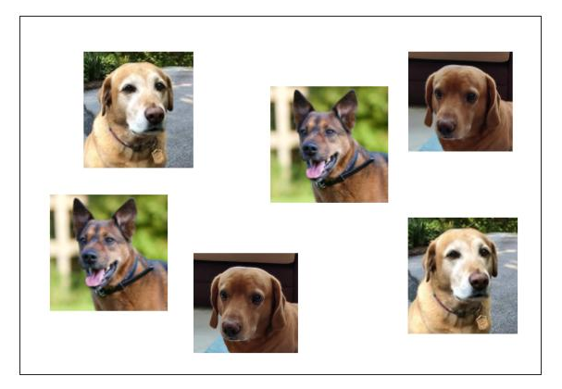
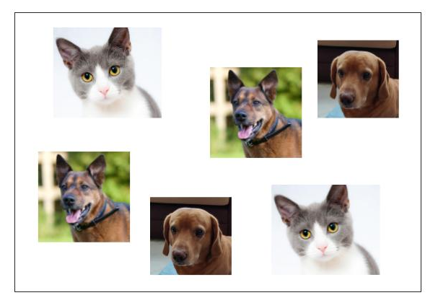
Experiment 1: Practice trials
All of the animals are pets.
Expected result: participants will pick the picture on the right (the second image).

Slide 10
Experiment 2: Practice trials
All of the animals are pets.
All of the animals are dogs.
Expected result: participants will pick the second sentence.

Slide 11


Practice trial 2
Some of the candles were lit.
All of the candles were lit.

Slide 12
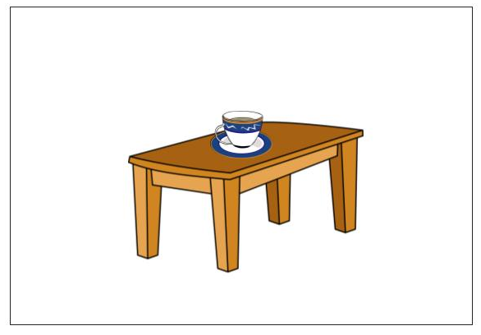
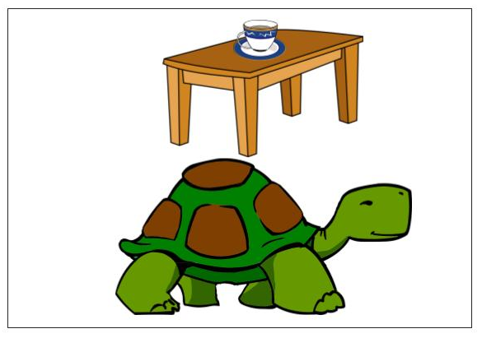
Practice trial 3
The cup is on the table.
The table is under the cup.

Slide 13
Questions at this point?

Slide 14
Creating surveys in Qualtrics
Download Qualtrics template from lab blackboard content section
You can access Qualtrics using your USC SSO:
https://itservices.usc.edu/qualtrics/
Create a new project (bottom left)
Survey from scratch
Name your survey
Select ‘Import a QSF file’
Import downloaded template
Add collaborators so all group members have access
Insert informed consent waiver (at beginning) and experimental materials (at end)
**REMEMBER: You need to create two surveys using this template, corresponding to the two variants of your experiment.

Slide 15
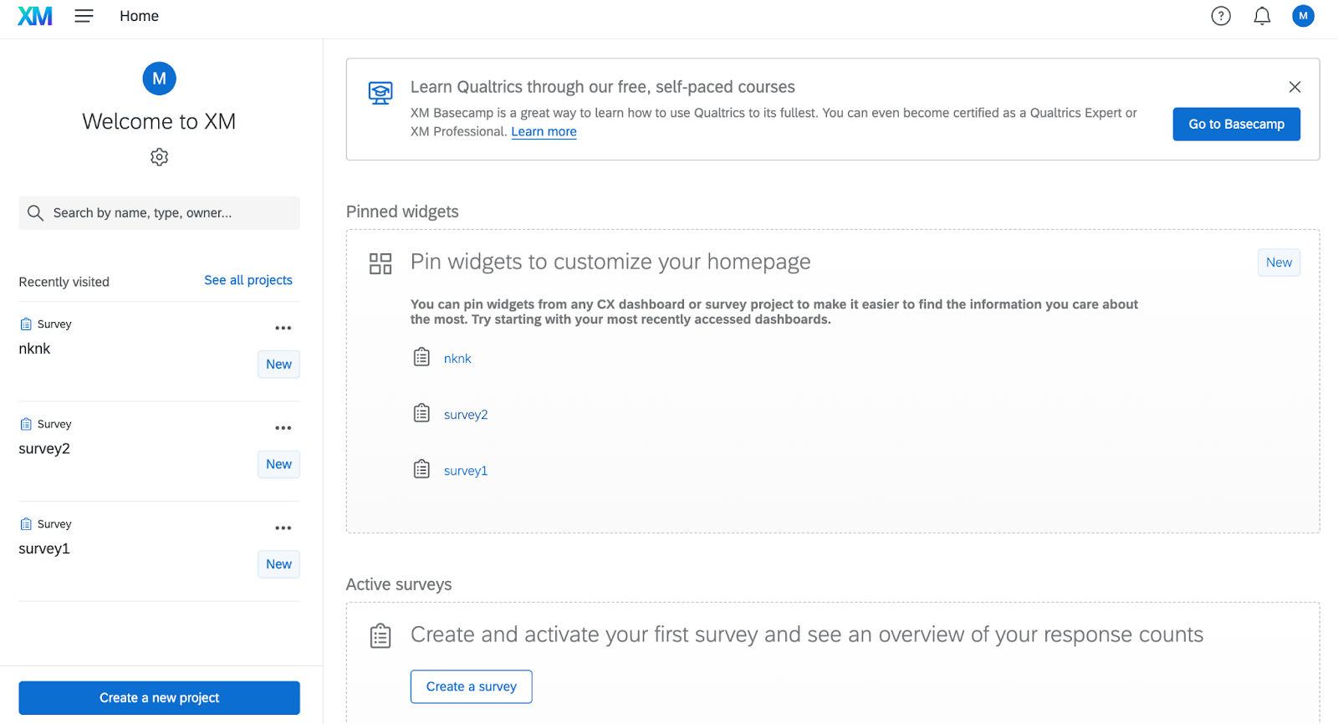
Screenshots for instructions
CLICK HERE

Slide 16
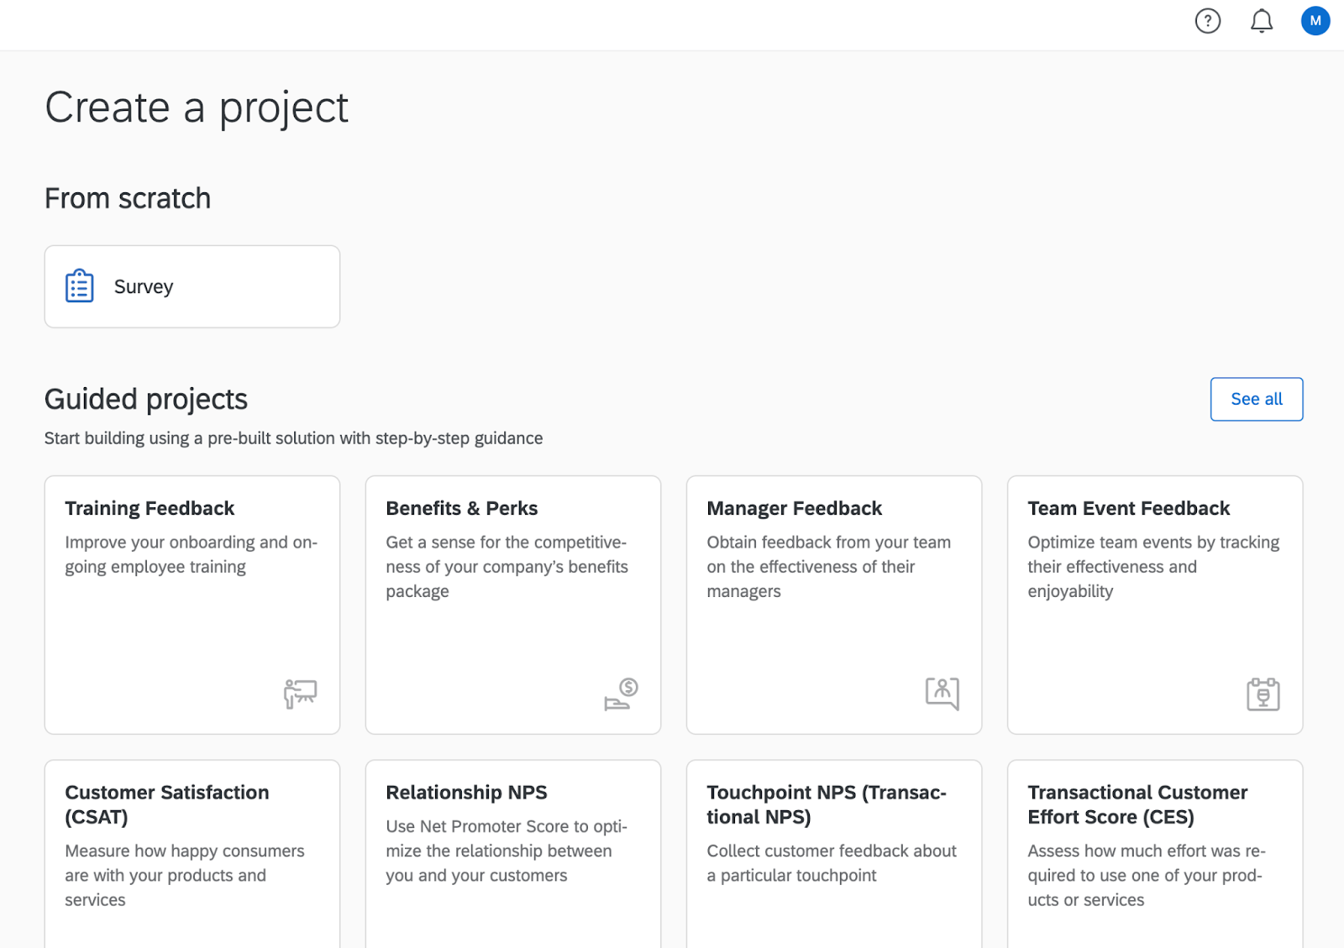
Screenshots for instructions
CLICK HERE

Slide 17
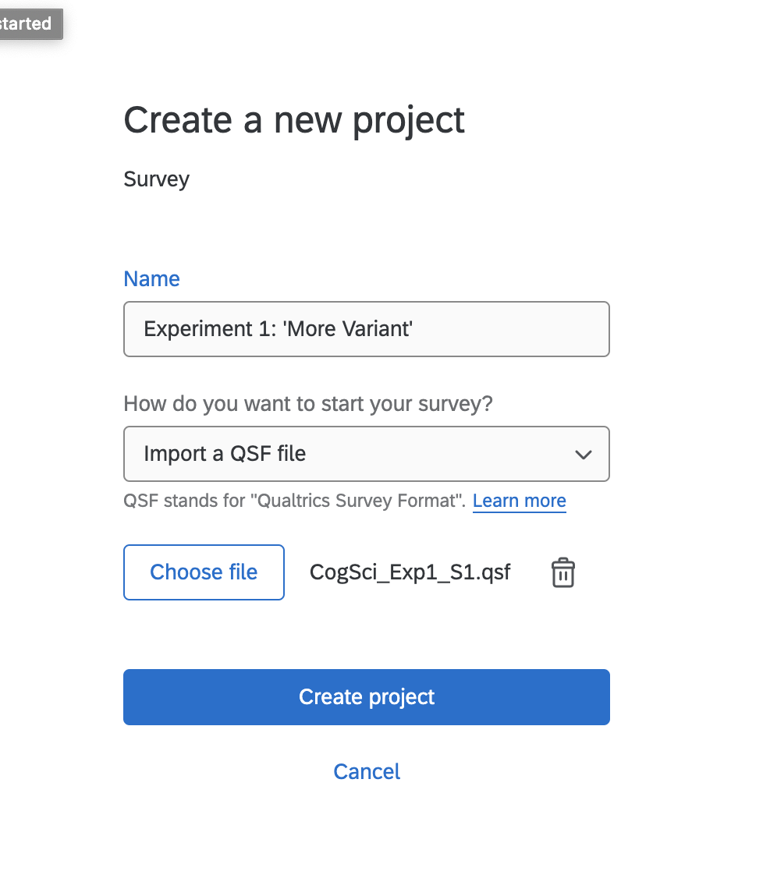
Screenshots for instructions
Put a title here
Choose ‘import a QSF file’
Import your experiment’s survey template
**REMEMBER: You need to create two surveys using this template, corresponding to the two variants of your experiment.

Slide 18
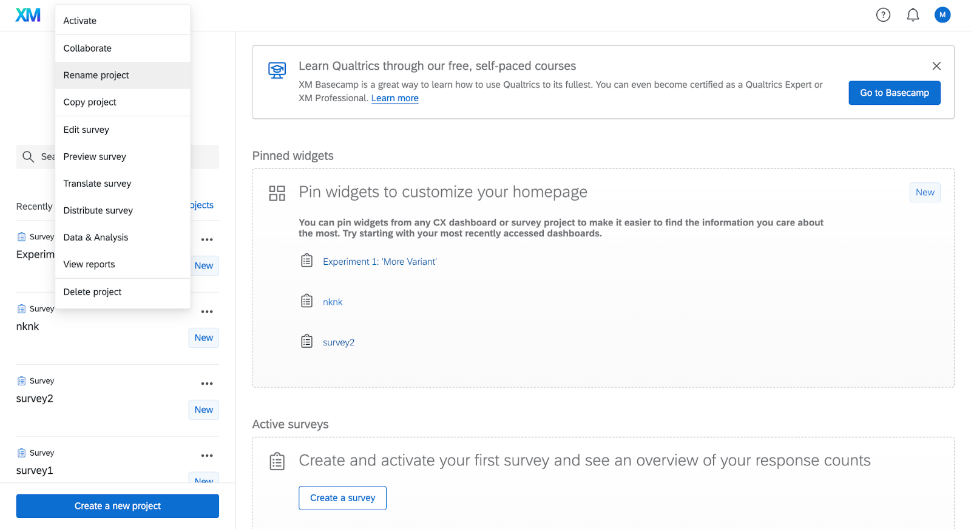
Screenshots for instructions
To add collaborators, click the three dots next to your survey on the homepage

Slide 19
Questions at this point?

Slide 20
Division of labor & participation grade
Your group can divide up the work however you like, but try to make sure that everyone is contributing equally.
For example, if your group has 3 members, you might divide it up like this:
One person writes the informed consent waiver
One person sets up the two Qualtrics surveys
One person organizes and formats the data
Remember, each group member needs to secure around 12 participants!
As part of your final lab report, each of you will submit a “Credit statement” detailing each groups member’s contribution. You will all need to agree to the contents of this statement.

Slide 21
Division of labor & participation grade
Participation in the lab is 14% of your final grade.
10% will be based on your attendance.
2% will be based on how actively you participated.
Participation takes many formats! Ex: speaking up in labs, completing lab activities in smaller groups, coming to office hours, etc.
2% will be based on how much you contributed to your group’s experiment.

Slide 22
Questions at this point?

Slide 23
SA4
SA#4 consists of completing the below instructions for two of the 4 assigned readings for Module 5 (i.e., Paper 1 response and Paper 2 response). You can earn up to 25 extra credit points for each additional response you provide (e.g., Paper 3 response or Paper 4 response).
Instructions: For each assigned reading you select, write a single paragraph of no more than 200 words that is responsive to (i) and (ii). An example paragraph that attempts to be responsive in this way is given below for Alt-Wellwood's claim that the Earth is flat. That paragraph is an extreme example designed to illustrate the genre of response that we're looking for. You need not strongly doubt the author's claim in order to feel out possible objections or counter-examples, and you must be generous in characterizing the author's claim that you criticize.
Specify, in your own words, one claim that the author makes. How do they defend it? Provide an example that the author's claim is intended to cover and how.
Specify an objection or counter-example to the author's claim. How might the author wish to respond? How problematic is it for the author's claim?

Slide 24
SA4
Alt-Wellwood claims that the Earth is flat. She says that, unless this were true, one could not explain why the Earth appears so. The author defends her claim by pointing out that none of her friends have been convinced by any of the purported evidence to the contrary, including photographs or videofeed of the Earth taken from space in which it appears round. However, it isn't particularly difficult to explain why the Earth looks flat from its surface, by simple appeal to properties of the human visual system and the sheer size of the Earth. Other types of evidence go unaddressed. For just one example, the private company Starlink launches satellites that provide internet access to a global base of around 250,000 customers. If the Earth were not round, this industry would not be possible. The author could respond by saying that Starlink's executives, employees, and customers are all in on a vast conspiracy designed to deceive humanity. However, this is implausible, given the number of people that would have to be in on it, and how widely entrenched, firmly established, and successful orbital science is. Correspondingly, there is little reason to believe Alt-Wellwood's claim.

Slide 25
SA4
Alt-Wellwood claims that the Earth is flat. She says that, unless this were true, one could not explain why the Earth appears so. The author defends her claim by pointing out that none of her friends have been convinced by any of the purported evidence to the contrary, including photographs or videofeed of the Earth taken from space in which it appears round. However, it isn't particularly difficult to explain why the Earth looks flat from its surface, by simple appeal to properties of the human visual system and the sheer size of the Earth. Other types of evidence go unaddressed. For just one example, the private company Starlink launches satellites that provide internet access to a global base of around 250,000 customers. If the Earth were not round, this industry would not be possible. The author could respond by saying that Starlink's executives, employees, and customers are all in on a vast conspiracy designed to deceive humanity. However, this is implausible, given the number of people that would have to be in on it, and how widely entrenched, firmly established, and successful orbital science is. Correspondingly, there is little reason to believe Alt-Wellwood's claim.

Slide 26
SA4
Alt-Wellwood claims that the Earth is flat. She says that, unless this were true, one could not explain why the Earth appears so. The author defends her claim by pointing out that none of her friends have been convinced by any of the purported evidence to the contrary, including photographs or videofeed of the Earth taken from space in which it appears round. However, it isn't particularly difficult to explain why the Earth looks flat from its surface, by simple appeal to properties of the human visual system and the sheer size of the Earth. Other types of evidence go unaddressed. For just one example, the private company Starlink launches satellites that provide internet access to a global base of around 250,000 customers. If the Earth were not round, this industry would not be possible. The author could respond by saying that Starlink's executives, employees, and customers are all in on a vast conspiracy designed to deceive humanity. However, this is implausible, given the number of people that would have to be in on it, and how widely entrenched, firmly established, and successful orbital science is. Correspondingly, there is little reason to believe Alt-Wellwood's claim.

Slide 27
SA4
Alt-Wellwood claims that the Earth is flat. She says that, unless this were true, one could not explain why the Earth appears so. The author defends her claim by pointing out that none of her friends have been convinced by any of the purported evidence to the contrary, including photographs or videofeed of the Earth taken from space in which it appears round. However, it isn't particularly difficult to explain why the Earth looks flat from its surface, by simple appeal to properties of the human visual system and the sheer size of the Earth. Other types of evidence go unaddressed. For just one example, the private company Starlink launches satellites that provide internet access to a global base of around 250,000 customers. If the Earth were not round, this industry would not be possible. The author could respond by saying that Starlink's executives, employees, and customers are all in on a vast conspiracy designed to deceive humanity. However, this is implausible, given the number of people that would have to be in on it, and how widely entrenched, firmly established, and successful orbital science is. Correspondingly, there is little reason to believe Alt-Wellwood's claim.

Slide 28
SA4
Alt-Wellwood claims that the Earth is flat. She says that, unless this were true, one could not explain why the Earth appears so. The author defends her claim by pointing out that none of her friends have been convinced by any of the purported evidence to the contrary, including photographs or videofeed of the Earth taken from space in which it appears round. However, it isn't particularly difficult to explain why the Earth looks flat from its surface, by simple appeal to properties of the human visual system and the sheer size of the Earth. Other types of evidence go unaddressed. For just one example, the private company Starlink launches satellites that provide internet access to a global base of around 250,000 customers. If the Earth were not round, this industry would not be possible. The author could respond by saying that Starlink's executives, employees, and customers are all in on a vast conspiracy designed to deceive humanity. However, this is implausible, given the number of people that would have to be in on it, and how widely entrenched, firmly established, and successful orbital science is. Correspondingly, there is little reason to believe Alt-Wellwood's claim.

Slide 29
SA4
Alt-Wellwood claims that the Earth is flat. She says that, unless this were true, one could not explain why the Earth appears so. The author defends her claim by pointing out that none of her friends have been convinced by any of the purported evidence to the contrary, including photographs or videofeed of the Earth taken from space in which it appears round. However, it isn't particularly difficult to explain why the Earth looks flat from its surface, by simple appeal to properties of the human visual system and the sheer size of the Earth. Other types of evidence go unaddressed. For just one example, the private company Starlink launches satellites that provide internet access to a global base of around 250,000 customers. If the Earth were not round, this industry would not be possible. The author could respond by saying that Starlink's executives, employees, and customers are all in on a vast conspiracy designed to deceive humanity. However, this is implausible, given the number of people that would have to be in on it, and how widely entrenched, firmly established, and successful orbital science is. Correspondingly, there is little reason to believe Alt-Wellwood's claim.

Slide 30
SA4 – General Advice
Be charitable when describing the author’s claim and when you are responding to your objection on their behalf.
Don’t: “Alt-Wellwood claims the Earth is flat. The only evidence she gives for this is because it appears that way to her.”
Don’t: repeat the original evidence in response to your objection.
Don’t assume that your reader agrees with you – use evidence that could convince someone who is on the fence!
Don’t simply state that the author is wrong. Explain why.
You don’t have to strongly believe that the author is wrong to write a response.
“One might object…” or “A possible objection to the author is…”
If you ultimately agree with the author, still make a strong objection!

Slide 31
Questions?

